Slide 1
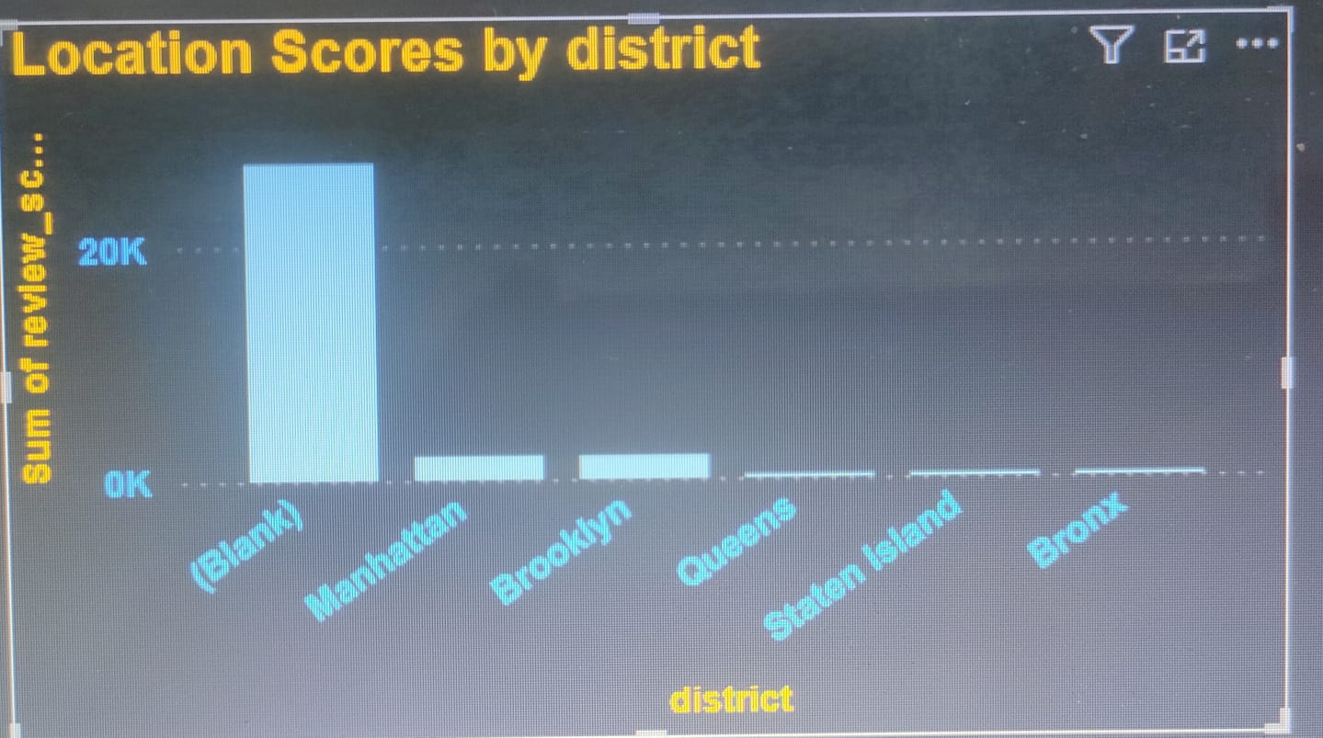
Report on Airbnb Data
OBJECTIVE :-
Identify the district with the lowest location scores.
Visualize Airbnb listing prices across different cities and identify trends.
Create and analyze a composite score integrating different scores.
Analyze the relationship between host response times and overall ratings.
Compute the age of listings and identify hosts with over ten years of experience.
Present listings prices, guest ratings, and visitor trends, focusing on changes in different years.
Show average prices for different room and property types in graphs.
Findings
There is lots of blanks in it.
Manhattan has the highest location scores.
Top 5 district location score wise is Manhattan , Brooklyn, Queens, Staten island, Bronx.
Bronx has the lowest location scores.

Slide 2
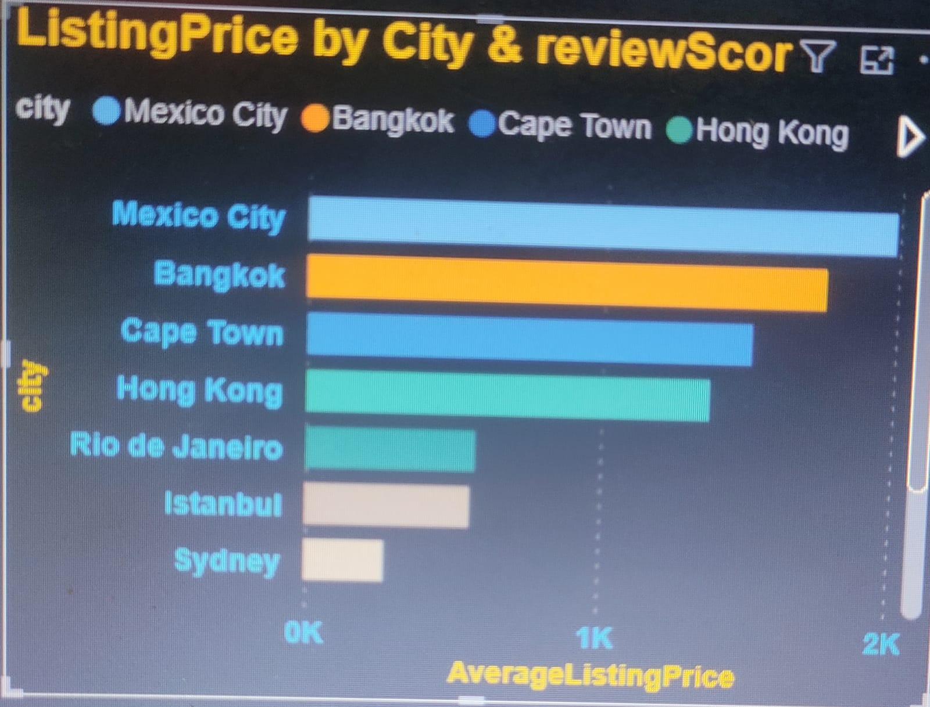
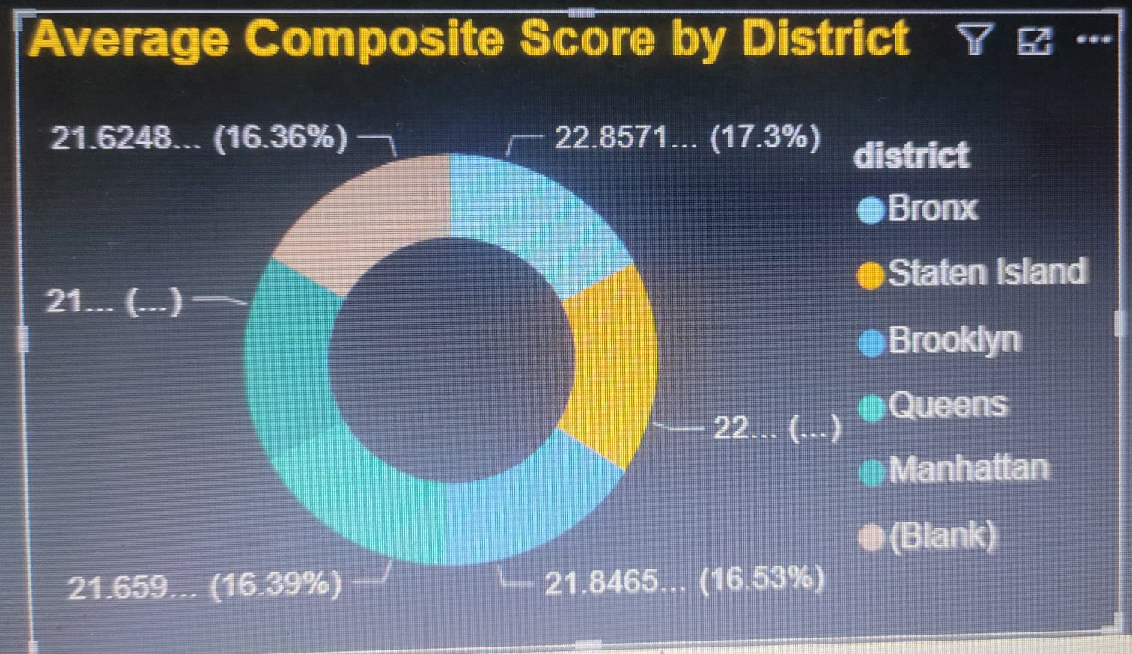
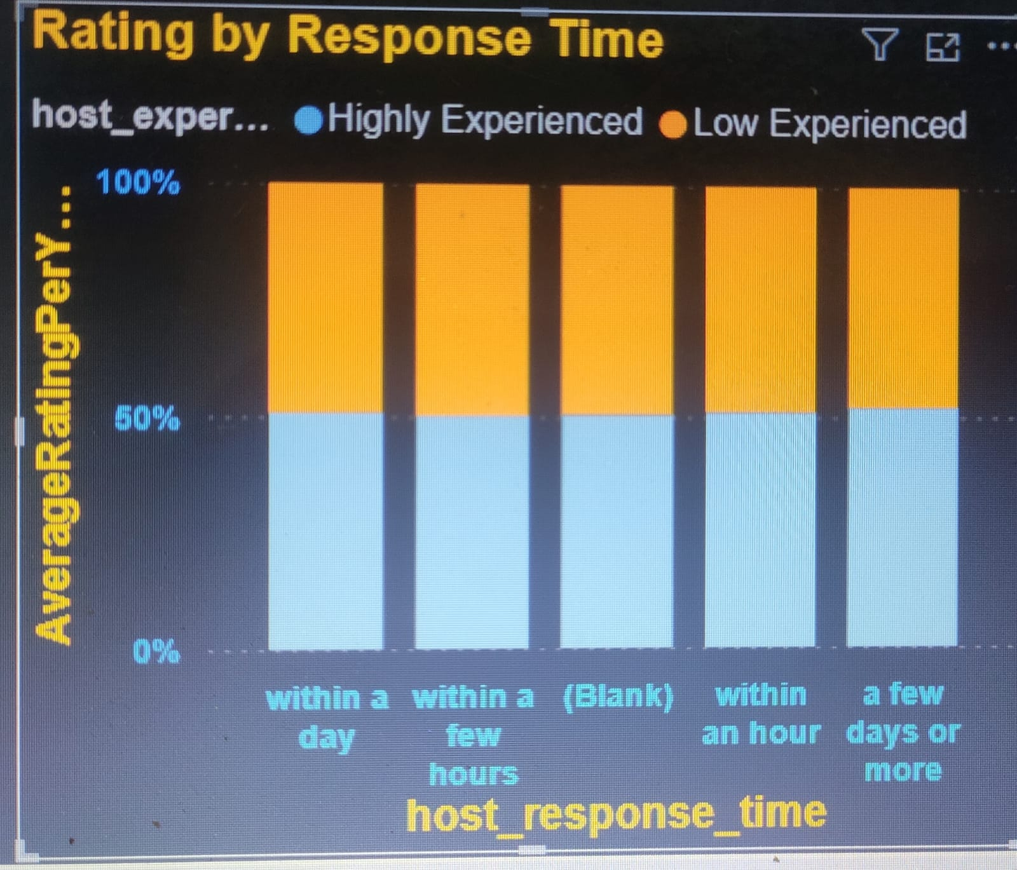
Findings
Mexico city has the highest average of listing price
Top 5 Cities having the highest average listing price
Mexico city, Bangkok, Cape Town, Hong Kong, Rio de Janeiro.
Average of listing price is 196.43
Findings
Bronx has highest average composite score
Top 5 District having the highest average composite score
Bronx, Staten island, Brooklyn, Queens, Manhattan.
Average of composite score is 21.64
Findings
Here we can see that there not much fluctuation in this graph.
Here 50 % host have at least 10 years of experience.
Average of rating per year is 94.10

Slide 3
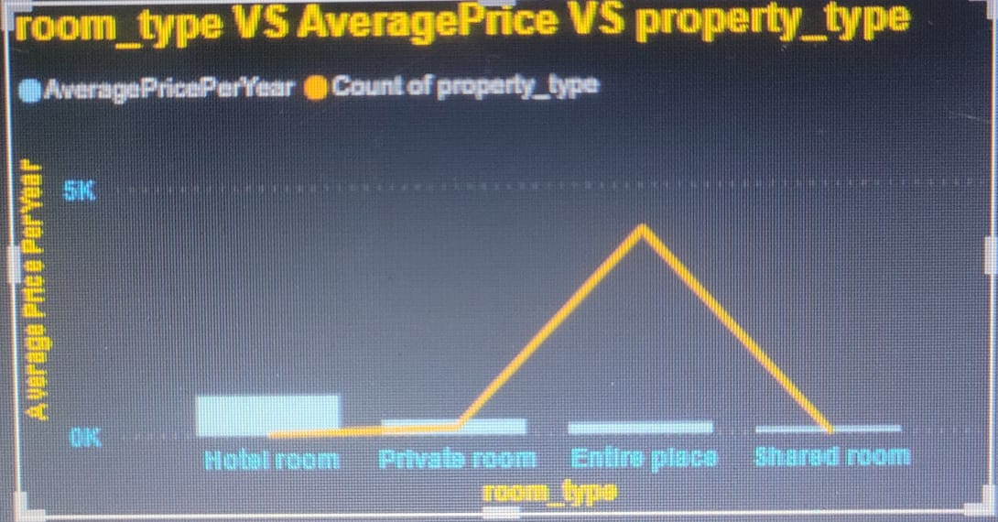
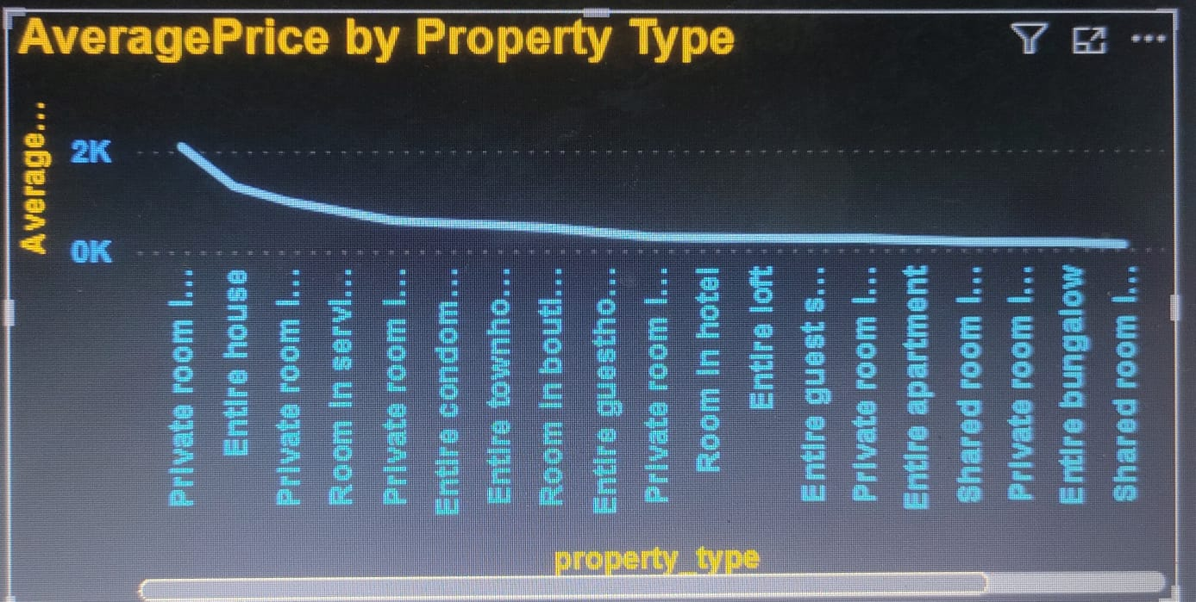
Findings
Hotel rooms has highest average price per year
Revenue wise top 4 room types
Hotel room, Private room, Entire place, Shared room
Average price per year is 196.43
Findings
Private room in town house is highest revenue generating property
Top 5 property type with highest average price
Private room in town house, Entire house, private room in tiny house, room in serviced apartment, private room in bed and breakfast
Recommendations :-
There is lots of blanks in this datasheet so we can organize awareness camp so everyone give feedback and we can provide them good services.
Shared rooms are generating very low revenue. We can give discounts on them and also we can advertise them for better outcome.
Bronx has lowest location scores. To promote this place we can host events there and give discounts on the many property types.
Mexico has highest listing price average. We can increase men power there so guest can have best experience so they come again.

Slide 4
Suggestion for tackling blanks
I have planned to create two new tables with same columns but it did not work
I want to replace null value with average of that particular column
Also I can see sum series going in some column so I also want fill these blanks with that series.
We can also connect to customer for proper data or can ask his views about this so he can have exact analysis for better outcome.
so these are my views to tackle these blank cells
But these can’t be use as these all are my assumptions and I don’t possess enough evidence to prove my views.
Vikas Singh ABADS - 13

